Slide 1
Exploring Calgary
Steven Tran

Slide 2
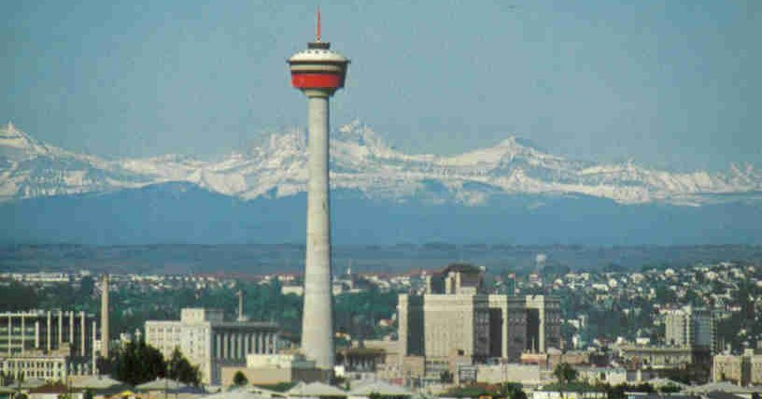
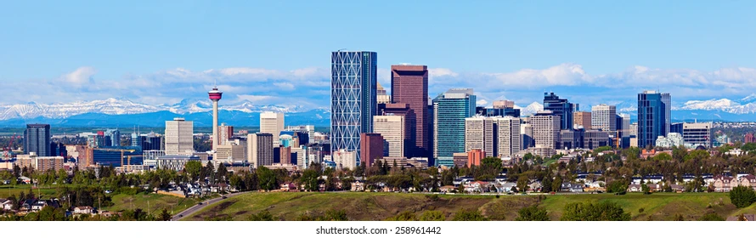
The Calgary Tower
Built in 1967 for $3,500,000
Used to store the Olympic flame during the 1988 Winter Olympics

Slide 3
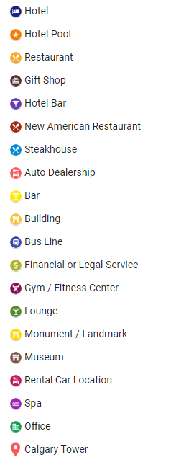
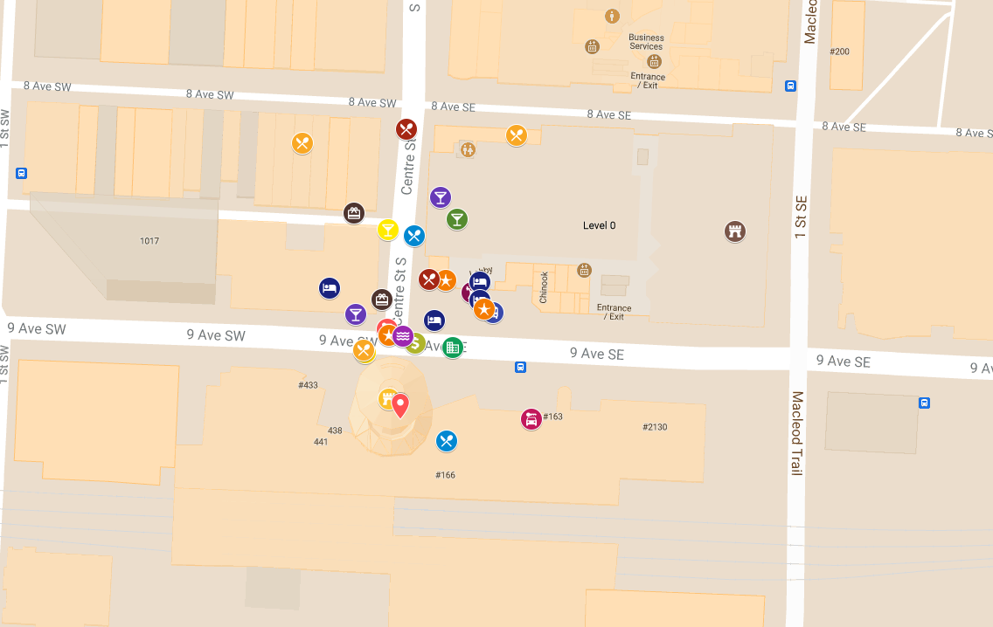
Four Square

Slide 4
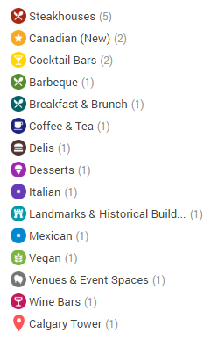
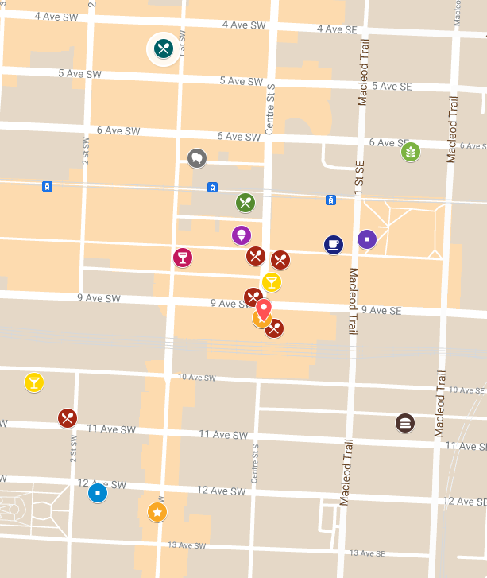
Yelp

Slide 5
Sub Databases
Reviews
*Venue ID
Number of Reviews
Rating
Main Database
Venues
*Venue ID
Name of Venue
Distance (m)
Main Category
Recommended by
Location
*Venue ID
Address
City
Province
Country
Latitude
Longitude

Slide 6
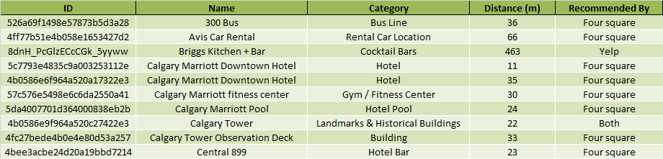
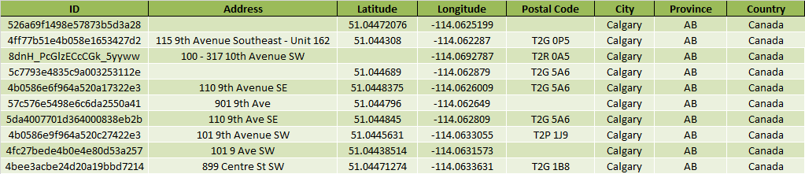
Main Database
Sub Databases

Slide 7
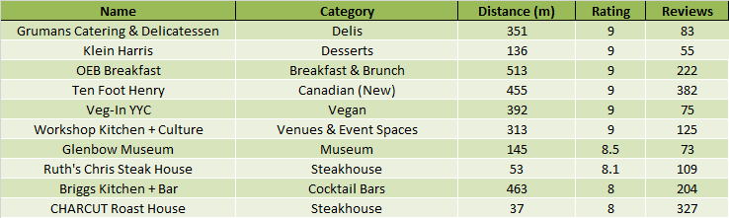
Top 10 Recommended Venues
Venues
Name of Venue
Distance (m)
Main Category
Recommended by
Number of Reviews
Rating
Venues
*Venue ID
Name of Venue
Distance (m)
Main Category
Recommended by
Reviews
*Venue ID
Number of Reviews
Rating
SORT FROM HIGH TO LOW

